Slide 1

Operational balanced scorecard
ISKCON Bangalore: May-2014

Slide 2
RECAP:BLOCK STRUCTURE
Strategy Council Body
New Projects (Obj. 9): MPP, CPP, JCD & AAD
Sustainable Alternative Lifestyle (Obj.10): MPP & JCD
Distribute the Holy Name and promote quality chanting (Obj.1): MPP
Team to be created
Deity Services & Festivals
VAKD
Obj.2, 11
Increasing Krishna Consciousness
(CES/Value Plus, FOLK, KA, LS)
CPP
Obj.3, 7, 11
For Profit
(SST, IC, GST, Kalyana Mantapa & Yatri NIwas, FRDC)
AAD
Obj. 4,6, 8, 11
Missionary Development
(Brahmacharis)
SKD
Obj.5A, 11
Missionary Development
(Grhasthas)
VAKD
Obj.5B, 11
Facilities, Utilities & Material Management: RKD
Administrative Block: HR, IT, DCC and Krishnamrita: AAD
Finance & Accounting-Fund Mgmt, Controls, Taxation, Budgeting Audit & MIS: MPP & JCD
PR, Strategic Communication & e-Presence: CPP
Legal, Secretariat, Liasioning

Slide 3
RECAP:OBJECTIVES
Distribute
Harinaam
Obj. 1
Sustainable
Living
Obj. 10
Deity Worship
& Festivals
Obj. 2
New Projects
Obj. 9
Notes:
Core Objectives of ISKCON-Bangalore are:
Objective 1: Distribute Holy Name and promote quality chanting.
Objective 2: To maintain opulent and gorgeous Deity worship along with festivals on a grand scale throughout the year.
Objective 3: To increase the awareness and appreciation of Srila Prabhupada - his message, his saintly personality, his character, his mission and his institution.
Objective 4: To distribute Srila Prabhupada’s books to desired target audience by engaging and inspiring them.
Objective 5: To maintain and nourish a vibrant, inspired and committed community of missionaries with mature understanding of Srila Prabhupada’s instructions for his Krishna consciousness movement.
Objective 6: To enlist and cultivate donors with the twin objectives of raising funds and making them life time supporters of the Krishna consciousness movement.
Objective 7: To increase Krishna consciousness among the desired sections of the society.
Children through CES and Values Plus.
Young people from SEC A, B and C families through FOLK program.
SEC C Families through Krishna Ashraya program.
SEC A and B families from business communities through Krishna Life program.
SEC A and B families from corporate and influencer communities through Life Sublime program.
SEC A and B families from celebrity and reputed communities through Life Sublime Premium program.
*** SEC stands for Socio Economic Classification.
Objective 8: To create for-profit activities that helps to further Krishna consciousness and is also in line with the principles of Krishna consciousness, to meet the expenses of temple activities.
Objective 9: To capitalize on opportunities that will help to further Krishna consciousness, help to present, preserve and promote the cultural heritage of India through new projects at VK Hill, Whitefield extension centre, Dharmapuri extension centre, school project and Annadana project.
Objective 10: To bring about a way of life that is in harmony with nature and offers a sustainable alternative to the dominant consumerist and materialistic world (Mahadevapura Farm and Bio-diesel Project)
Objective 11: To promote sustainable and socially responsible practices while achieving the above objectives.

Slide 4
OBJECTIVE 2:
To maintain opulent and gorgeous Deity worship along with festivals
on a grand scale throughout the year
How is the Temple being perceived as a place of “Public Interest”?
Deity & Festivals, Facilities & Utilities, Dhananjaya, PR and e-Presence Divisions
Notes:
How is the temple being perceived as a place of “Public Interest”?

Slide 5
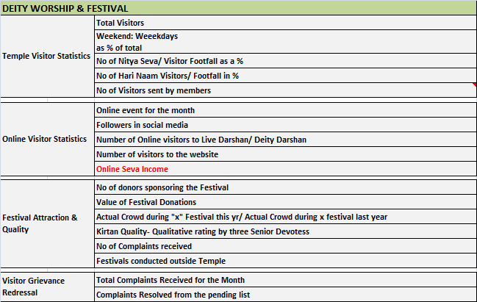
MEASURES
Measures for which data is not available

Slide 6
TEMPLE VISITOR STATISTICS
-2% Drop
Trough
Crest
Declining visitors since 2011-2012

Slide 7
VISITOR STATISTICS-QTR BREAKUP
 | Q1 | Q2 | Q3 | Q4
2008-2009 | 9,65,928 | 6,61,893 | 7,38,157 | 10,98,120
2009-2010 | 13,74,243 | 10,47,960 | 9,26,215 | 7,68,160
2010-2011 | 10,73,197 | 8,23,459 | 9,39,227 | 8,34,377
2011-2012 | 11,82,332 | 12,53,497 | 9,39,668 | 9,46,990
2012-2013 | 12,28,079 | 10,31,583 | 9,42,659 | 10,12,193
2013-2014 | 10,51,823 | 9,10,107 | 8,85,331 | 8,70,179
Average | 11,45,934 | 9,54,750 | 8,95,210 | 9,21,670
Q1 Visitors to Temple is highest; Drop in all quarters of FY 12-13

Slide 8
VISITOR STATISTICS-FESTIVAL
Name of Festival | Festival Dates FY 12-13 | Festival Visitors FY 12-13 | Festival Dates FY 13-14 | Festival Visitors FY 13-14 | % Change
Brahmotsavam | Apr 5th to 16th | 97,041 | Apr 24th to May 5th | 1,05,933 | 9% Increase
Janmastami | Aug 9th & 10th | 1,10,193 | Aug 27th to 28th | 1,09,571 | 1 % Decrease
Vaikuntha Ekadashi | Dec 23rd | 81,849 | Jan 11th | 73,358 | 10% Decrease
Overall drop in Festival Crowd is marginal at 0.1%
Can more occasions in form of event/utsav increase footfall?
Can more synergy between PR and Dhananjaya Teams help increase footfall?

Slide 9
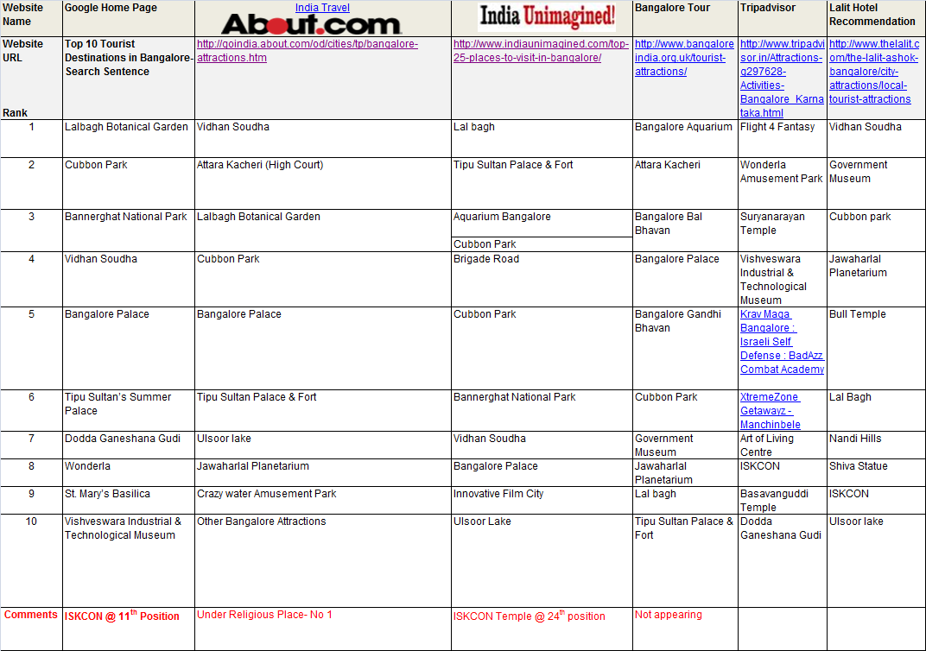
RANKING IN TOP TOURIST WEBSITES
ISKCON, Bangalore not amongst the top 10.
Tripadvisor & Hotel recommendation has higher ranking

Slide 10
TEMPLE VISITOR OUTCOME
Visitor Outcome | FY 12-13 |  | FY 13-14
Nitya Seva Participation | 2,236Average Tickets *** Data from Dec 12 to Mar 13 | 2.04% | 2,177 Average Tickets | 2.1%
Harinaam Mantapa Participation | 94933 Average Harinaam Visitors | 27% | 61366 Average Harinaam Visitors | 20%
Hundi Income against footfall | Annual Income of Rs 2,73,59,425 | Rs 6/ visitor | Annual Income of Rs 2,82,21,285 | Rs 8/ visitor
Books against footfall @ Avg SKU Price Rs 80 | Annual Income of SST Books: Rs 4,67,94,000 | 14% visitors are buying | Annual Income of SST Books: Rs 3,75,77,000 | 13% are buying
Paraphernalia against footfall @ Avg SKU Price Rs 200 | Annual Income of SST Non Books: Rs 7,98,89,000 | 9% visitors are buying | Annual Income of SST Non Books: Rs 10,30,53,000 | 14% are buying
Food (Temple Stores) against footfall @ Avg SKU Price Rs 50 | Annual Income of Temple Stores: Rs 4,67,94,000 | 33% visitors are buying | Annual Income of Temple Stores:Rs 3,75,77,000 | 41% are buying

Slide 11
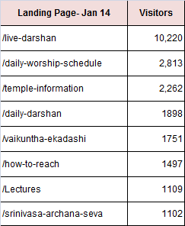
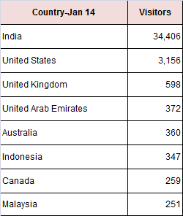
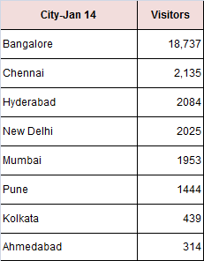
ONLINE VISITORS-WEBSITE
Online viewership is increasing in mobile and tablet

Slide 12
ONLINE VISITORS-FACEBOOK
There were more than 750 million people on Facebook, each with an average of about 136 friends. Every time someone "Likes" your page or something on it, he exposes it to all his friends, who then have the opportunity to expose it to their friends
Increasing trend on “likes” indicates exponential exposure
Notes:
Exponential Exposure
Because of the viral nature of social networking, brand and product exposure on Facebook grows exponentially. At the time of publication, there were more than 750 million people on Facebook, each with an average of about 136 friends. Every time someone "Likes" your page or something on it, he exposes it to all his friends, who then have the opportunity to expose it to their friends
Targeting
When Facebook users "Like" your page or its content, his friends will notice either in advertisements or on their News Feeds. Since friends often share common interests, when someone likes your product or business, he exposes it to other people who are more likely to have similar preferences than someone picked at random. In this way, you naturally target the audience who is most likely to be interested in your brand, service or product
Validation
People ask their friends when they want a second opinion about where to go or what to buy. If someone "Likes" your business' Facebook page or something on it, he validates it to his friends. Furthermore, when someone clicks on your page, he sees a list of which of his friends "Like" it. Your advertisements also display to any user which of his friends "Like" your page.
Customer Community and Loyalty
Facebook users who "Like" a business' Facebook page receive updates about that page in their News Feeds. In this way, they have the opportunity to stay informed about your business and can even engage in conversations or applications on your page. This builds a customer community around your page and generates customer loyalty.
"Likes" Linked to More Business
The proof of Facebook's marketing effectiveness is in business website visitation rates. People who "Like" your Facebook page and their friends are more likely to visit your website and use your products or services. According to research published by the web analytics service KISSmetrics, 2.7 percent of average Internet users have visited Southwest.com, while 12.4 percent of Facebook users who "Like" Southwest have visited the site and 7.1 percent of their friends have visited it. Similarly, people who "Like" Bing and their friends consistently use Bing for Internet searches more frequently than other Internet users

Slide 13
ONLINE VISITORS-FACEBOOK
The Facebook talking about this as the number of unique users that have engaged or interacted with your page in the past week in some form or another. The higher this number the better because that means people are engaging with your content, wall posts, pictures, etc
Engagement is highest during festivals & events

Slide 14
FACEBOOK-DEMOGRAPHY GENDER & AGE
73%
26%
Data as on March 14

Slide 15
FACEBOOK-DEMOGRAPHY LOCATION

Slide 16
FACEBOOK-DEMOGRAPHY LOCATION

Slide 17
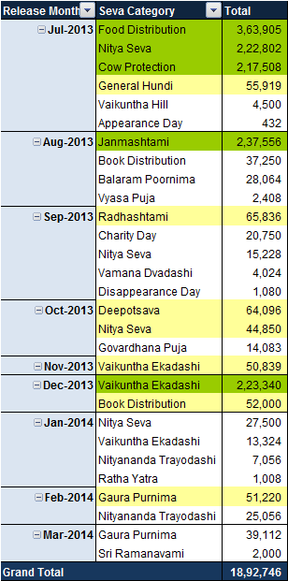
ONLINE VISITOR OUTCOME
FY 12-13 : ~ INR 8.73 lacs
FY 13-14: ~ INR 21 lacs
*** Accounting heads to be created to include donation through e-channel
Average Duration of the event
Is about a month

Slide 18
FESTIVAL OUTCOME
Festival Name *** All values in Lacs | FY 12-13 |  | FY 13-14
 | No of Transactions | Value of Donation | No of Transactions | Value of Donation
Brahmotsava | 106 | 12.39 | 138 | 30.26
Sri Krishna Janmashtami | 603 | 74.24 | 384 | 77.70
Sri Krishna Janmashtami - Direct Mailer | 534 | 8.49 | 454 | 7.14
Vaikuntha Ekadashi | 174 | 24.67 | 193 | 26.16
Vaikuntha Ekadashi - Direct Mailer | 318 | 4.60 | 421 | 6.76
Other Festivals | 441 | 33.81 | 152 | 18.70
Total | 2176 | 158.20 | 1742 | 166.73

Slide 19


RECAP:OBJECTIVE 2
Mixed Results
Timeliness of Regular Deity Service
Less or no emergencies, manageable
Extra Hands available and training is getting
done to handle peak load
Online presence increasing amongst interest
groups
Online & Festival Donation have increased
Deity
Worship
& Festivals
Obj. 2
Decreasing visitors
No information on visitor profile
No mechanism to close visitor grievance
Visitor engagement with temple yet to be
established:
Religious Sentiment
Tourist Destination
Mix of both
Deity service yet to start outside temple

Slide 20
NEXT STEPS-OBJECTIVE 2
Deity & Festivals, Facilities & Utilities, Dhananjaya, PR and e-Presence Divisions
What | Who | When
Live Darshan Quality | RKD & BRD | 15 days from now
Twitter account for all SC members | BRD | This week
Analysis of visitor data | RKD | 15 days
Festival Date with days | ALC | Tomorrow
More visitors- Musical fountain etc | SC Body | Next SC Meeting
Track web based revenue as a separate account heads | AAD | 1 week time
Festival Outcome FY 11-12 Data | ALC | tomorrow
IT deprt to forward grievances to correct person for closure | RKD | 1 month
Closure Reporting | RKD | 1 month
Advertise website and facebook | AAD | 1 month
Visitor Profile and feedback -wireless | SC Body | 2 months

Slide 21
OBJECTIVE 1:
Distribute Holy Name and promote quality chanting
OBJECTIVE 3:
To increase the awareness and appreciation of Srila Prabhupada - his message,
his saintly personality, his character, his mission and his institution
OBJECTIVE 4:
To distribute Srila Prabhupada’s books to desired target audience by engaging and inspiring them
OBJECTIVE 7:
To increase Krishna consciousness among the desired sections of the society.

Slide 22
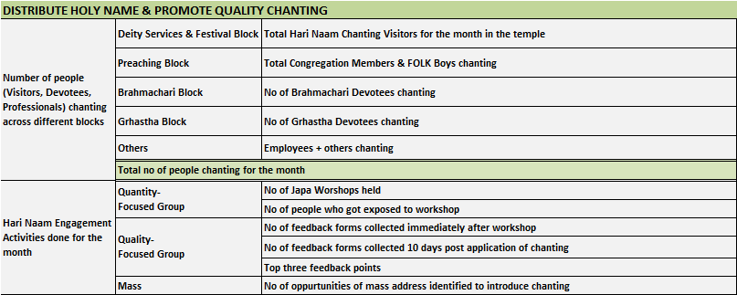
MEASURES:OBJECTIVE 1
Measures for which data is not available

Slide 23
CHANTING STATISTICS
Rounds of Chanting | Harinaam Mantapa | FOLK Boys | Brahmachari Ashram | Employees ***Committed Rounds
1 Round | 7,36,388; 20% FY 13-14 11,39,193; 27% FY 12-13 | 31 Boys |  | 1 Employee
2 Rounds |  | 40 Boys
3 Rounds |  | 2 Boys
4 Rounds |  | 35 Boys |  | 2 Employees
5 Rounds |  | 2 Boys
6 Rounds |  | 15 Boys
8 Rounds |  | 31 Boys |  | 4 Employees
10 Rounds |  | 4 Boys |  | 1 Employee
12 Rounds |  | 3 Boys
13 Rounds |  | 1 Boys
16 Rounds |  | 120 Boys | 76 Devotees | 69 Employees
Total: 284 Boys
Total: 77 Employees
Data missing for congregation members & Grhasthas

Slide 24
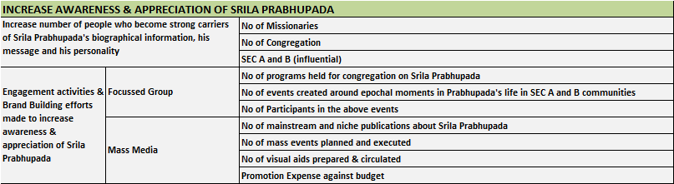
MEASURES:OBJECTIVE 3
Measures for which data is not available

Slide 25
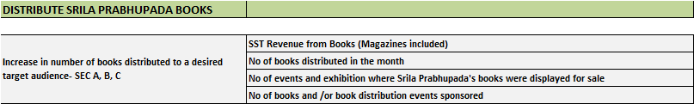
MEASURES:OBJECTIVE 4
Measures for which data is not available

Slide 26
DISTRIBUTION OF SRILA PRABHUPADA BOOKS
Particulars | FY 11-12 | FY 12-13 | FY 13-14 | Variance %
Number of Srimad Bhagavatam Sets Distributed | 1,863 | 1320 | 927 | -30%
Number of Books of Srila Prabhupada Distributed in the temple apart from the SB Sets
Small Books | 118,356 | 140,381 | 78,217 | -44%
Medium Books | 32,898 | 35,600 | 33,290 | -6%
Big Books | 68,872 | 74,427 | 64,386 | -13%
CC Sets | 44 | 26 | 139 | 435%
Small & Medium Book Sets | 1,996 | 5734 | 4,083 | -29%
Number of Magazines with Krishna Consciousness messages distributed
Krishna Voice (English) | 486,590 | 4,29,400 | 499,813 | 16%
Bhakti Vedanta Darshan (Kannada) | 245,090 | 1,94,960 | 227,921 | 17%
FY 12-13 SST Books Revenue: INR 467.98 lacs
FY 13-14 SST Books Revenue: INR 375.77 lacs
Drop: 20%

Slide 27
ENGAGEMENT ACTIVITIES ON BOOKS
No of Events & Exhibitions where Srila Prabhupada’s books were displayed for sale:
Events: 41
Exhibitions: 5
Remarks: Lal Bagh Flower exhibition , Freedom Park -Khadi Mela at
Blore /Chickamagalur , GKVK Krishi mela ,Times Kidz World exhibition
B. No of books and /or book distribution events sponsored if any : None

Slide 28
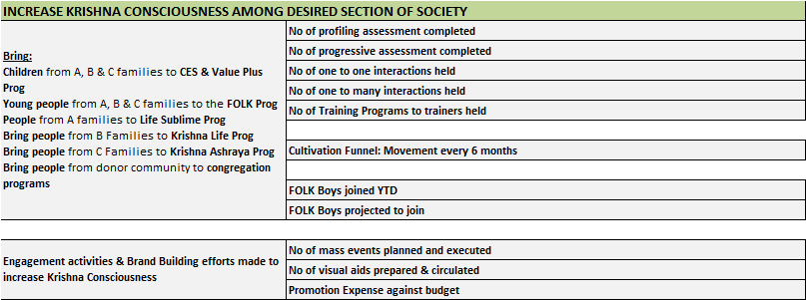
MEASURES:OBJECTIVE 7
Measures for which data is not available

Slide 29
FOLK SNAPSHOT
No of FOLK Boys who have joined Ashram during FY 13-14: 10 Boys
No of FOLK Boys who are at the end of the funnel : 28 Boys
L3 : 18 Boys
L4 : 10 Boys
L5 : None
All the 28 Boys have a high probability of joining, FY 14-15 onwards (none are expected to
leave)
No of FOLK Guides who have joined during FY 13-14: 4
No of FOLK Guides transferred during the period: 5
Training imparted to FOLK Guides: Informal training by CPP Prabhu
on Monday evening meetings

Slide 30
PROFILE OF FOLK BOYS
Data to be Checked

Slide 31
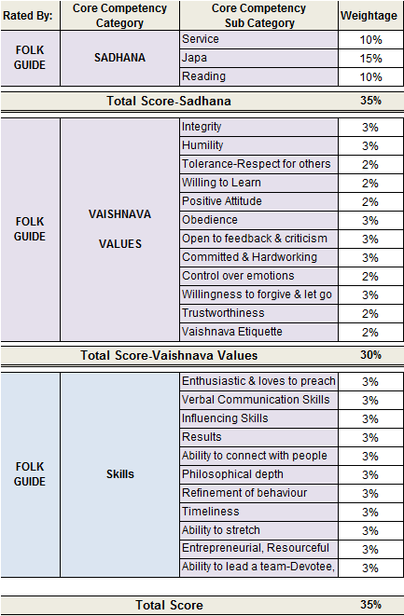
Competency Parameters
Exercise to
ascertain the
Quality of Folk Boys

Slide 32
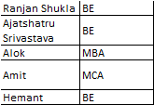
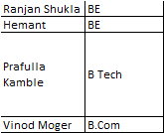
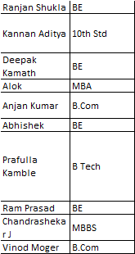
Functional Score Spread
Enthusiastic & Loves to Preach with Good Verbal Communication
Good Verbal Communication, Ability to influence & connect
Good Philosophical Depth

Slide 33
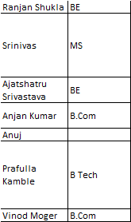
Functional Score Spread
Entrepreneurial, Resourceful and innovative
Ability to lead

Slide 34
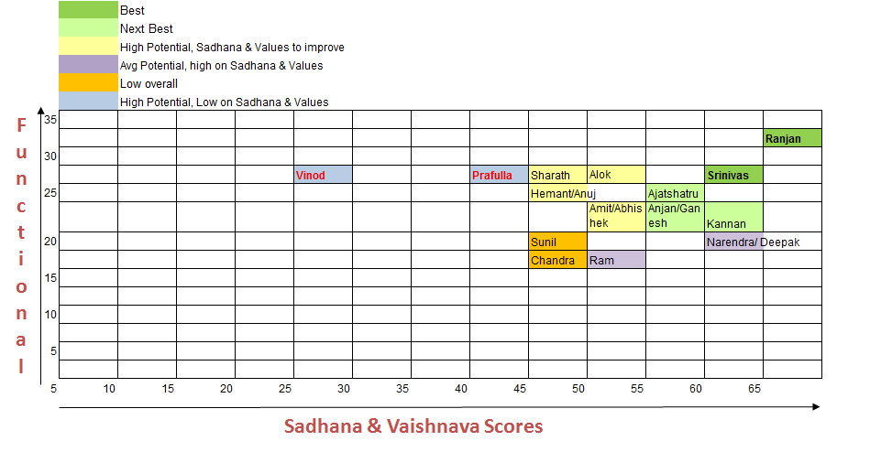
Balanced Score
** This is only an indicative score and can be used to get a perspective on how competency mapping
exercise can benefit the organization.

Slide 35
RECAP:OBJECTIVES 1, 3, 4 & 7
Distribute
Harinaam
Obj. 1

Slide 36
NEXT STEPS-OBJECTIVE 1, 3, 4 & 7
Increasing Krishna Consciousness Block, Dhananjaya, SST, PR
What | Who | When
Which Devotees can be freed for preaching | SC
What are the positions which can be headed by Professionals | ALC | Next BSC Review
MPP and Anant Kirti Prabhu to own the Holy Name Obj | MPP
Obj 3: To identify a second line for Obj 3 (SP Awareness) | SC | today
Sridhar Venkat on SEC A and B
SC Body to have a strategic decision on expanding congregation (Obj 7) | SC
Grhastha will be handled by RKD Prabhu | RKD
FOLK to get a better mix of students | Sampati Prabhu

Slide 37
OBJECTIVE 5:
To maintain and nourish a vibrant, inspired and committed community of missionaries
with mature understanding of Srila Prabhupada’s instructions
for his Krishna consciousness movement
Brahmachari Ashram , Grhastha Ashram

Slide 38
ASHRAM PERFORMANCE:
SADDHANA REPORT:
Mangal Aarti, Darshan Aarti, Srimad Bhagvatam Class, Japa & Reading
COMPETENCY REPORT
Saddhana Scores, Vaishnava Value Scores, Functional Scores

Slide 39
SADHANA REPORT HIGHLIGHTS
No of Devotees: 58
Sadhana Parameters: Mangal Aarti, Japa, Darshan Aarti, Srimad Bhagvatam Class Attendance
and Reading Hrs.
Months when data is collected: July, August, September, October & November.
Level of Exercise: Preliminary, some data points need validation as there could be recording errors.
Purpose: While data was being collected, this is the first attempt towards summarizing.
End Objective: Provide a high level summary on the quality of Sadhana practice in the Ashram.

Slide 40
Mangal Aarti Attendance
Data Source: Biometric
45%
14%
41%

Slide 41
Darshan Aarti Attendance
Data Source: Biometric
98%
0%
2%

Slide 42
Srimad Bhagvatam Class Attendance
Data Source: Biometric
36%
26%
38%

Slide 43
Completion of Japa before 10 am
Data Source: Manual
36%
22%
41%

Slide 44
Average Reading Hrs per day
Data Source: Manual
36%
22%
41%

Slide 45
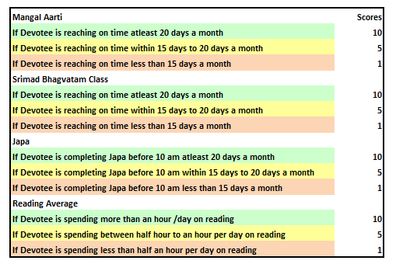
Sadhana Score Definition
Darshan Aarti Score not included as attendance is good across

Slide 46
Consistency across all Sadhana parameters
Counseling to start with 22 Devotees, followed by 13 and then 8 Devotees

Slide 47
COMPETENCY REPORT HIGHLIGHTS
No of Devotees: 76
Competency Parameters: Saddhana, Vaishnav Values & Functional.
Month & Year of Rating: April, 2014.
Rating done by: Saddhana Rating by Ashram, Vaishnav Value Rating by Senior Devotees and
Functional Rating is by Supervisor.
Level of Exercise: Level 1, to be repeated once every 6 months or once a year.
Purpose: This is the first attempt to have structured estimation of Brahmachari Performance.
End Objective: Provide a high level summary on the quality of Brahmachari Resource in the Ashram.

Slide 48
COMPETENCY REPORT: DEVOTEE SPREAD

Slide 49
Overall Competency Score across Functions
6 Devotees
5 Devotees
26 Devotees
11 Devotees
10 Devotees
15 Devotees
Drop in “Competency Score” for functions with:
- higher responsibility &
- ones that involve greater interaction with people

Slide 50
SADDHANA SCORES

Slide 51
Average Saddhana Scores by Function
Overall Score drop for Functional Head contributed by drop in Saddhana Scores
FOLK Guides too have low Saddhana Scores

Slide 52
VAISHNAVA VALUE SCORES

Slide 53
No of Devotees with Low Vaishnava Value Scores

Slide 54
Average Vaishnava Value Scores by Function
Overall Score drop for Fund Raising Function contributed by drop in Vaishnava Value Scores

Slide 55
FUNCTIONAL SCORES

Slide 56
Functional Skills of Functional Head
Provides input for “functional training need identification exercise”

Slide 57
Competency Distribution-Functional Head
 | Moderate on Saddhana & Values High on Functional Skills | High on Saddhana & Values Highon Functional Skills (5,4) Shyama Vallabha Dasa (92,86) Sachi Tanaya Dasa (90, 80)
Low on Saddhana & Values Moderate on Functional Skills Amogh Lila Dasa (54, 60) | Moderate on Saddhana & Values Moderate on Functional Skills Krishna Saka Dasa (64, 74) Akinchana Chaitanya Dasa (78, 66) Kulashekhara Chaitanya Dasa (67, 63) Kodanda Rama Dasa (70, 60) Navina Nirada Dasa (68, 60) | High on Saddhana & Values Moderately High on Functional Skills (3,4) Anantha Kirti Dasa (90,77) Vamsidhara Dasa (80, 71) Sukhadeva Dasa (90, 66) Mahaprabhu Gauranga Dasa (90, 60)
Low on Saddhana & Values Low on Functional Skills Prahladeesha Dasa (50, 57) Patita Pavana Dasa (46, 54) Lakshmisha Dasa (48, 49) | Moderate on Saddhana & Values Low on Functional Skills Aravindaksha Dasa (67, 54) Radhe Shyam Dasa (62, 54) Suguna Krishna Dasa (60, 49)
High
80
Medium
Functional Scores
60
Low
40
Low
60
Medium
80
High
Saddhana & Vaishnav Value Scores

Slide 58
Functional Skills of Fund Raising Devotees
Provides input for “functional training need identification exercise”

Slide 59
Functional Skills of FOLK Guides
Provides input for “functional training need identification exercise”

Slide 60
Competency Distribution-Fund Raising & FOLK Guide
 | Moderate on Saddhana & Values High on Functional Skills Maha Vishnu Dasa (77, 86) Rasajna Dasa (70, 80) Mahotsaha Chaitanya Dasa (60, 80) | High on Saddhana & Values Highon Functional Skills (5,4)
Low on Saddhana & Values Moderate on Functional Skills | Moderate on Saddhana & Values Moderate on Functional Skills Ishvara Puri Dasa (75, 60) Nanda Kishora Dasa (77, 60) Pracheta Dasa (77,74) Raghukula Nandana Dasa (65, 74) Lakshmana Dasa (67, 63) Varada Simha Dasa (68, 60) Shyama Krishna Dasa (63, 77) Gunakara Rama Dasa (67, 74) Sampati Dasa (61, 63) Mohana Chaitanya Dasa (75, 60) | High on Saddhana & Values Moderately High on Functional Skills (3,4) Jagat Jivan Dasa (80, 60) Sadananda Dasa (80, 71) Vainateya Dasa (80, 69) Kala Kantha Dasa (80, 66) Kalanidhi Dasa (80, 63) Vilasa Vigraha Dasa (80, 60)
Low on Saddhana & Values Low on Functional Skills Pankaja Nabha Dasa (57, 49) Hemanga Chaitanya Dasa (57, 49) | Moderate on Saddhana & Values Low on Functional Skills
High
80
Medium
Functional Scores
60
Low
40
Low
60
Medium
80
High
Saddhana & Vaishnav Value Scores

Slide 61
Functional Skills of Entry Level Devotees
Provides input for “functional training need identification exercise”

Slide 62
Competency Distribution-Entry Level Devotees
 | Moderate on Saddhana & Values High on Functional Skills Arjuna Sakha Dasa (77, 80) | High on Saddhana & Values Highon Functional Skills (5,4) Chaitanya Chandra Dasa (90, 80) Lakshminatha Dasa (90, 80) Karuna Keshava Dasa (90, 80) Madhava Hari Dasa (90, 80) Badri Narayana Dasa (90, 80) Jivanmukta Dasa (90, 80) Raseshvara Dasa (80, 80) Vrajeshwara Dasa (80, 80) Indirapati Dasa (80, 80) Bh. Satin (80, 80)
Low on Saddhana & Values Moderate on Functional Skills | Moderate on Saddhana & Values Moderate on Functional Skills Vasudevasuta Dasa ( 77, 77) Madhura Murali Dasa (77, 74) Madhavendra Puri Dasa (74, 71) Bh. Sachidananda (69, 71) Sriniketana dasa (70, 63) Ananda Krishna Dasa (72, 60) Bh. Harish (70, 60) | High on Saddhana & Values Moderately High on Functional Skills Rama Raghava Dasa (87, 77) Prahlada Prana Dasa (80, 74) Kamala Paada Dasa (80, 60)
Low on Saddhana & Values Low on Functional Skills Gaura Mohan Dasa (47, 49) Santana Jivana Dasa (46, 43) Vishnurata Dasa (43, 37) | Moderate on Saddhana & Values Low on Functional Skills Shrestha Rupa Dasa (62, 54) Nilachala Chandra Dasa (68, 54)
High
80
Medium
Functional Scores
60
Low
40
Low
60
Medium
80
High
Saddhana & Vaishnav Value Scores

Slide 63
ASHRAM ENGAGEMENT ACTIVITIES
Devotee Learning & Development
Bhakti Shastri Course
Krishna Communication Workshop by CPP Prabhu to 15 Senior Devotees
Krishna Consciousness Foundation Course for Freshers
Everyday course on Srimad Bhagvatam by Senior Devotees
Devotee Well Being
Track on Devotees falling sick & repeat cases of same ailment
One-o-One session with SKD Prabhu

Slide 64
RECAP:OBJECTIVE 5
Counseling
Training & identification of trainers
Devotee well being tracking
Devotee Saddhana & Vaishnav Value tracking
Functional Competence Identification
Help Devotees to balance Saddhana and
functional responsibility.
Grooming of Devotees to take higher
responsibility
More train the training sessions
Devotee Database maintenance is manual

Slide 65
NEXT STEPS-OBJECTIVE 5
Brahmachari Ashram , Grhastha Ashram
What | Who | When

Slide 66
OBJECTIVE 6:
To enlist and cultivate donors with the twin objectives of raising funds
and
making them life time supporters of the Krishna consciousness movement
Dhananjaya & DCC

Slide 67
Total Cost of Fundraising
Measure: Total YTD (April 13 to Feb 14) Cost of Fundraising in lacs (INR)
Status
Notes:
1. Ownership for reducing cost of fundraising has to be attached & reviewed

Slide 68
Cost of Fundraising
Measure: Cost of Fundraising
Head | Apr | May | Jun | Jul | Aug | Sep | Oct | Nov | Dec | Jan | Feb
Rolling Average ( 3months) (X+Y+Z)/ Total Collection |  |  | 21% | 23% | 18% | 18% | 19% | 20% | 23% | 25% | 28%
Traditional Avg. Cost of Fund raising is 23% to 27% . Efficient functioning can result in % being less than 15%.
At ISKCON though, cost optimization chances are higher as fund raising is
done by Devotees.
Status
Notes:
1. Cost as % of Collection is increasing as cost remains same or tends to rise while total collection has dropped

Slide 69
Total Collection this FY v/s last
Measure: YTD (April 13 to Feb 14 ) Collection
*** All values in lacs
16% Drop
Status

Slide 70
Total Monthly Collection this FY v/s last
Measure: Monthly Collection
*** All values in lacs
Status

Slide 71
Corpus v/s Non Corpus
Measure: Corpus v/s Non Corpus
*** All values in lacs
Down by 20%
INR 220 lacs less
Down by 4%
INR 14 lacs less
Status

Slide 72
Monthly Corpus Collection this FY v/s last
Measure: Monthly Corpus Collection
*** All values in lacs
Status

Slide 73
Monthly Non Corpus Collection this FY v/s last
Measure: Monthly Non Corpus Collection
*** All values in lacs
Status

Slide 74
Fund Raising Streams v/s Fund Raising Methods
Notes:
Shown in matrix but no collection data is available from what ever information has been produced. In case of Educational Donation, everywhere “x” is indicated although Preacher data records this stream of donation
With so many streams , so many methods and so many sevas, there will be lack of focus. Hence streamlining and responsibility attachment is key.

Slide 75
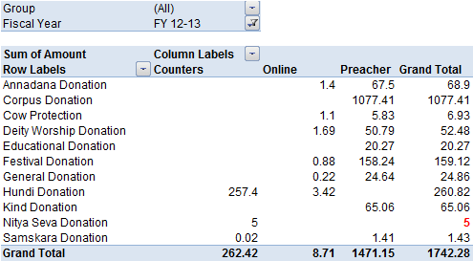
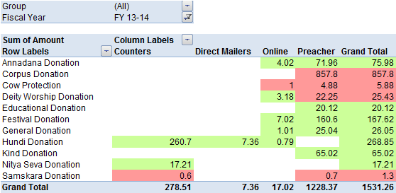
Fund Raising Streams YoY
*** All values in lacs

Slide 76
New Enrolment this FY v/s last
Measure: YTD (April 13 to Feb 14 ) Enrolment
*** All values in lacs
22% Drop in
Value
Status
Notes:
1. Fall in donation owing to transfer of performing preachers to Delhi is taken, the reason for drop in enrolment is not understood

Slide 77
Renewals
Measure: Renewals
Total Value of Renewals : INR 340 lacs
28% of the Total Collection
Status

Slide 78
House Performance
Measure: Collection by House Lead- YTD Value and YTD % of Total Collection
*** All values in lacs
FY 13-14 | SRKD | ACRD | MHVD | RGND | Others
Average Monthly Collection by House | 27 | 14 | 21 | 13 | 29
Status

Slide 79
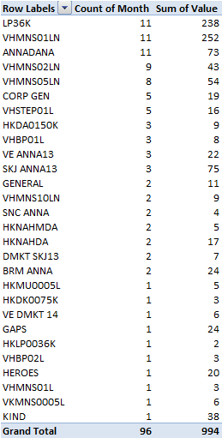
Product & Scheme Performance
Measure:
Seva Codes that have
Demonstrated consistent performance
Across months, contributing 80% of the total
Collection.
~ 70 Seva Codes with nil or poor collection

Slide 80
RECAP:OBJECTIVE 6
Audit findings: Low non-conformance
Cheque bounce instances, manageable
Weekly meetings with House Leads
Division performance sharing with House Leads
PDC recovery exercise started
Low new enrollment
Less renewals
Ownership by donation streams
House Leads to change from being individual
individual contributors
SKU rationalization
Team needs to capitalize on cross department
strengths
Functional skills enhancement

Slide 81
NEXT STEPS-OBJECTIVE 6
Dhananjaya, DCC, e-Presence, PR, Deity Services & Festivals
What | Who | When

Slide 82
OBJECTIVE 8:
To create for-profit activities that helps to further Krishna consciousness and
is also in line with the principles of Krishna consciousness,
to meet the expenses of temple activities.
Revenue Block, Facilities & Utilities

Slide 83
REVENUE OF ALL TRUSTS
All values in lacs.

Slide 84
REVENUE OF SST; BOOKS & NON BOOKS
All values in lacs.

Slide 85
REVENUE OF SST; EXTERNAL & INTERNAL
All values in lacs.

Slide 86
REVENUE OF IC
All values in lacs.

Slide 87
REVENUE OF IB
Divisions | FY 12-13 | FY 13-14 | % Variance | Remarks
Retail ( F&B, Halls & Lawns) | 1,82,17,241 | 2,94,20,598 | 61% | Non 80G Donation, General Donation, Kalyana Mantapa Rental, Cancellation & Other Income, MVT, Other Income
CES | 58,81,511 | 79,96,870 | 36% | Cultural & Educational Tours, Cultural & Educational Fees
Hospitality | 91,21,072 | 1,15,12,333 | 26% | Dharmasala Income
Dhananjaya | 2,07,70,930 | 2,51,53,056 | 21% | Scholarship Donation, Non 80G Donation, General Donation, Samskara, Deity Worship Donation, Golden Altar Donation, Nitya Seva, Ghosala, Sponsorship Income, Interest on Savings & FD
Value Plus Program | 1,57,50,596 | 1,86,01,877 | 18% | India Heritage Studies Income
E Presence | 7,25,000 | 8,00,000 | 10% | Other Income
Temple Management & Support Services | 6,25,43,521 | 5,69,97,678 | -9% | Hundi, Non 80G Donation, General Donation, Festival Donation, , Nitya Seva, Pushpanjali, Darshan Seva, Deity Worship Donation, Golden Altar Donation Footwear, MVT, Interest on Savings & FD
Indian Heritage Programs | 2,50,624 | 1,72,712 | -31% | Festival Donation, Cultural & Educational Tours
Estate Management +F & U | 4,40,56,062 | 2,61,05,068 | -41% | Rental from different Trusts, Footwear, Parking, Other Income (Rs 1.6 C)
VK Hill | 44,38,060 | 25,27,002 | -43% | Non 80G Donation, Hundi, Pushpanjali
F & B (Krishnamrita) | 25,375 | 15,55,064 |  | Employee Food Coupons, Festival Coupons

Slide 88
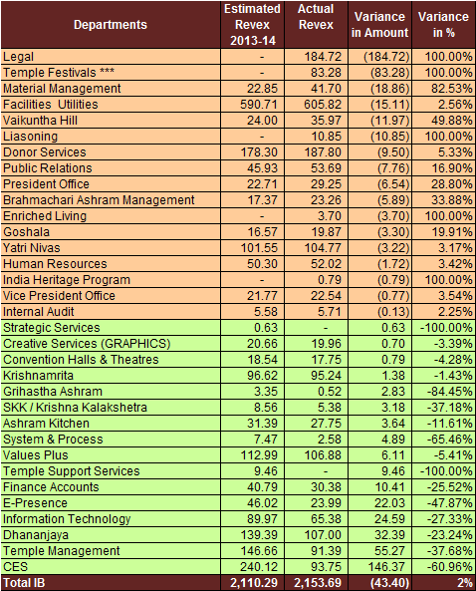
EXPENSE OF IB AGAINST ESTIMATE
Expense overshot of 2%
over estimated Revex
All values in lacs.

Slide 89
EXPENSE OF IB AGAINST LAST YEAR
FY 12-13 Actual Expense: Rs 19,04,52,265
FY 13-14 Actual Expense: Rs 22,55,11,292
Increase: Rs 3,50,59,027 ; % Increase: 18%
Top 80% Expense Head | FY 12-13 | FY 13-14 | Variance
Legal Fee | 1,08,49,094 | 1,79,58,668 | 71,09,574
Salary & Wages | 5,82,01,606 | 6,25,98,207 | 43,96,601
Food Distribution | 1,31,99,186 | 1,67,85,779 | 35,86,593
Donations to Charitable Trusts | 1,99,263 | 36,94,654 | 34,95,391
House Keeping Labour | 1,14,44,395 | 1,41,85,645 | 27,41,250
Repairs & Maintenance General | 54,18,679 | 80,83,995 | 26,65,316
Educational/Cultural Trip Exp. | 9,93,016 | 30,77,251 | 20,84,235
Labour Charges | 19,90,285 | 32,30,417 | 12,40,132
Water Charges | 29,65,688 | 39,34,101 | 9,68,413

Slide 90
People Statistics
Measure: Employee Count in FY 13- 14 v/s FY 12-13
4% More Employees
Increase : 34
Status
Notes:
1. The same information has to be seen by comparing the employee expense between two FY and also by comparing the revenue to employee ratio across two FY

Slide 91
People Statistics including Contract
854
Status

Slide 92
People Statistics Across Sections
Sections | FY 12-13 | FY 13-14 | Variance | % Change
IB | 357 | 370 | 13 | 4%
GST | 13 | 18 | 5 | 38%
SST | 182 | 179 | -3 | -2%
IC | 266 | 285 | 19 | 7%
IHF | 2 | 2 | 0 | 0%
Total | 820 | 854 | 34 | 4%
Status

Slide 93
People Statistics Against Revenue
SECTIONS | FY 12-13 |  |  | FY 13-14
 | REVENUE (in lacs) | EMP COUNT | REV PER EMP (in lacs) | REVENUE (in lacs) | EMP COUNT | REV PER EMP (in lacs)
GST | 324 | 13 | 24.9 | 469 | 18 | 26.0
SST | 1267 | 182 | 7.0 | 1408 | 179 | 7.9
IC | 1721 | 266 | 6.5 | 1964 | 285 | 6.9
IB | 1819 | 357 | 5.1 | 1821 | 370 | 4.9
Total | 5131 | 818 | 6.3 | 5662 | 852 | 6.6

Slide 94
Employee Strength Across Key Sections
ISKCON Bng | IC | SST | GST | IHF
370 | 285 | 179 | 18 | 2
Status

Slide 95
Employee Strength Across IB Divisions
Decrease as compared to FY 12-13
+ 2
Same strength as compared to FY 12-13
+ 1
Increase as compared to FY 12-13
+ 2
+ 5
+ 1
+ 9
+ 4
+ 6
+ 1

Slide 96
Employee Strength-IB (Prasadam) & TSF
+ 2
+ 1
+ 1
+ 4
+ 2
+ 1
+ 6
+ 8
+ 2
+ 1
+ 1

Slide 97
Employee Salary
Total Salary Outflow in Revenue Block: INR 60,37,570 (IC, SST, GST)
Status

Slide 98
Employee Overtime & Incentive Salary
Components
Status

Slide 99
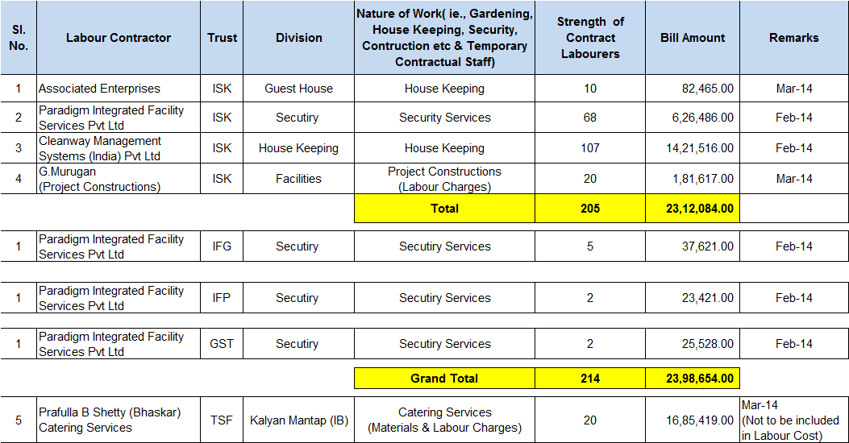
Labour Contractors
Status

Slide 100
RECAP:OBJECTIVE 8
Increase in overall revenue
Kalyana Mantapa, IC, SST, Dharmashala Revenue increase
Overall budgeting exercise close
High dependency on temple crowd
Expense on the rise
Manpower optimization, scope for improvement
Low Capacity Utilization

Slide 101
NEXT STEPS-OBJECTIVE 8
Revenue Block, Facilities & Utilities
What | Who | When

Slide 102
ISKCON OVERALL OBJECTIVE PERSPECTIVE
Distribute
Harinaam
Obj. 1
Sustainable
Living
Obj. 10
Deity Worship
& Festivals
Obj. 2
New Projects
Obj. 9

Slide 103
ISKCON OVERALL BLOCK PERSPECTIVE
Deity Services & Festivals
Preaching
Increasing KC
Revenue
Donation
Revenue
For Profit
Ashram
Brahmachari
Ashram
Grhastha
VAKD
CPP
AAD
AAD
SKD
VAKD
Obj.2, 11
Obj.3,7, 11
Obj. 6, 11
Obj. 4, 8, 11
Obj. 5, 11
Obj. 5, 11
Expense
Expense
Expense
Expense
Expense
Information unavailable in this discussion
Employee Count
Employee Count
Employee Count
Employee Count
Employee Count
Festival & Deity Worship Mgmt in Temple
FOLK
CES
Non Corpus
SST, IC, GST
Dharmasala
Counseling
Saddhana & Vaishnava Value Tracking
Functional Competency identification
Macro level Training identification
Corpus
Non Corpus
Cost of Funding
New Enrollment
Renewals
Devotee Productivity
Value Plus
Books
Internal Business Process
People Productivity
Nitya Seva
Harinnam
Outside Temple event
Temple drawing public attention
Preaching
(SEC A,B,C)
Increasing Awareness & appreciation for Srila Prabhupada, KC
R&R
KRA
Accountability
Balancing functional responsibility with Saddhana
Devotee preparedness for higher responsibility
Devotee Training
Emergency Mgmt
Training
Identification of Devotees
Training
Weekly Progress Disc
House Lead
Ownership assigning

Slide 104
ISKCON OVERALL BSC PERSPECTIVE
FINANCIAL
Overall Revenue
Revenue increase- KM, IC, SST, Dharmasala
Cheque Bounce: manageable
Expenses have increased
Donation reduced
Cash Flow Visibility
Manpower productivity
Capacity Utilization
CUSTOMER
Festival Donation & Participation
Online Participation
Top 10 rating on tripadvisor & Hotel Lalit Ashok
recommendation
Deity Worship & Temple Altar appreciation
Decreasing Temple Visitors
Low rating on popular tourist destination
Low Nitya Seva & Harinaam Participation
Deity Worship is limited to temple
New enrolment & renewals low
Preaching practice is limited
INTERNAL
BUSINESS
PROCESS
Budget Exercise, a beginning
PDC Recovery exercise
Policy adherence
Festival/ Event management
Facility Management
Opportunity identification for Japa
Workshops, preaching, awareness on
Srila Prabhupada
Divisions functioning in silos
Poor synergy between Accounts & Operation
SKU, manpower & capacity optimization
LEARNING
AND
DEVELOP-
MENT
Competency Mapping for Devotees
Training
Trainer identification
On-time Salary processing
IT innovation & e-Presence
Employee R&R clarity
Employee training
Identifying roles that can be best served by
Devotee, Devotee Professionals & employees
Creation of second and third line of managers

Slide 105
HARE Krishna !

